Slide 1
Best Practices for Java Coding
Writing Clean, Efficient, and Maintainable Java Code

Slide 2
Introduction
Importance of best practices
Benefits of clean code: readability, maintainability, and scalability

Slide 3
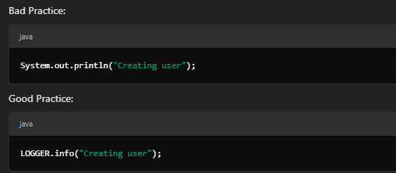
Proper Logging
Remember: Use structured, level-based logging frameworks like SLF4J or Log4j.

Slide 4
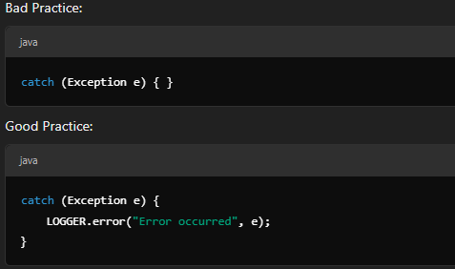
Graceful Exception Handling
Remember: Handle exceptions gracefully and avoid empty catch blocks.

Slide 5
Separation of Concerns
Remember: Avoid mixing responsibilities. Separate business logic, data access, and UI into distinct layers.

Slide 6
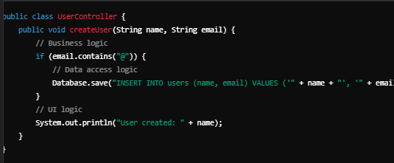
Bad Practice
Issues:
UI (System.out.println) is coupled with business logic.
Direct interaction with the database violates separation of concerns.

Slide 7
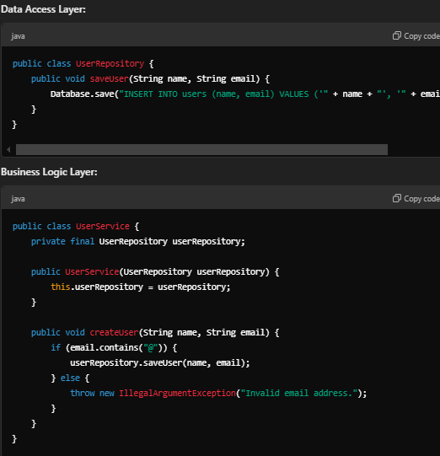
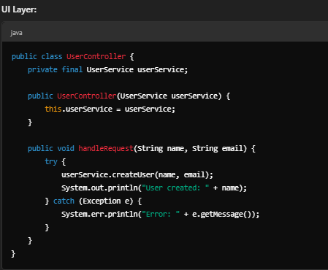
Good practice
Benefits of Separation
Each layer is independent, making the code modular and easier to maintain.
Testing is simplified—e.g., you can test the UserService without worrying about database or UI.
Adhering to SOLID principles ensures better scalability and readability.

Slide 8
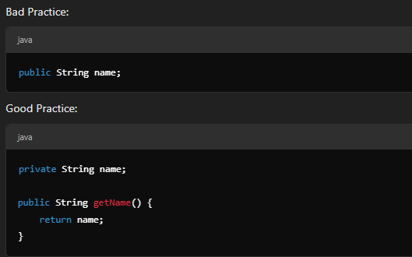
Encapsulation
Remember: Always use private fields with getters and setters.

Slide 9
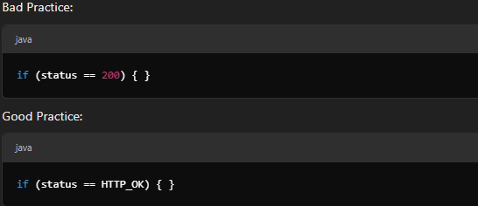
Avoid Magic Numbers
Remember: Replace magic numbers with named constants for readability and maintainability.

Slide 10
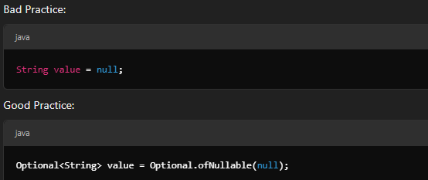
Use Optional
Remember: Use Opt
ional for cleaner, safer code that avoids NullPointerExceptions

Slide 11
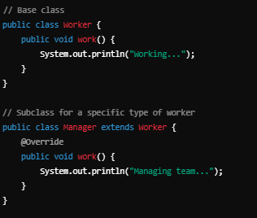
Avoid Overusing Inheritance
Remember: Favor composition over inheritance to increase flexibility and reduce tight coupling.
Issues with Inheritance:
Rigid Hierarchy: Adding new behaviors may require creating multiple subclasses, leading to a complex and rigid class hierarchy.
Limited Flexibility: A class can inherit from only one superclass (single inheritance), restricting the ability to combine behaviors.
Tight Coupling: Changes in the superclass can inadvertently affect all subclasses, leading to potential issues.

Slide 12
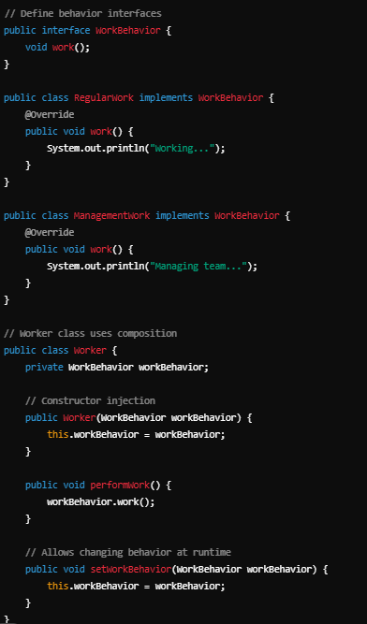
Benefits of Composition
Increased Flexibility: Behaviors can be changed or combined at runtime without altering the class hierarchy.
Reusability: Behavior classes can be reused across different contexts without duplication.
Reduced Coupling: Classes are less dependent on a fixed hierarchy, making the system more modular and easier to maintain.

Slide 13
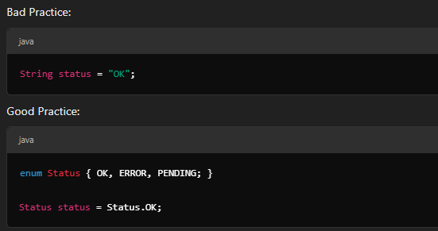
Enums for Constants
Remember: Use enums for well-defined sets of constants and type safety.

Slide 14
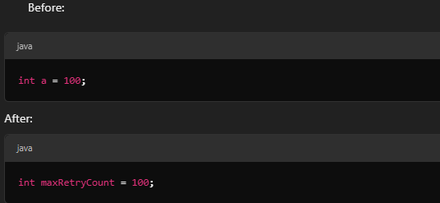
Coding Standards
Remember: Use proper naming conventions, consistent formatting, and meaningful comments.

Slide 15
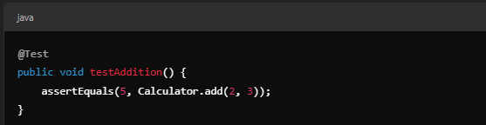
Testing and Debugging
Write unit tests using JUnit or TestNG
Use logging frameworks for debuggin

Slide 16

Code Reviews and Collaboration
Peer reviews for feedback and knowledge sharing
1
Use static analysis tools like SonarQube
2
Maintain proper documentation
3

Slide 17
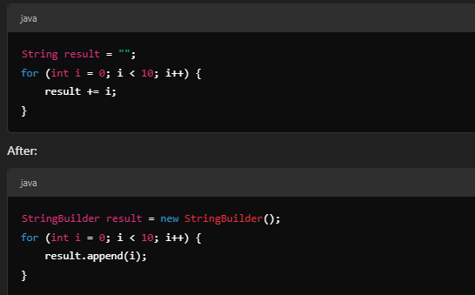
Optimizing Performance
Remember: Avoid premature optimization; focus on clean design. Use StringBuilder for concatenations
.

Slide 18
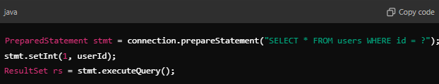
Security Best Practices
Validate inputs to prevent SQL injection
Use environment variables for sensitive data
Use secure libraries for cryptographic operations

